Slide 1
Bank Data Analytics Dashboard
- Presented by Mohammad Aasim

Slide 2
Executive Summary
This dashboard analyzes bank loan data across multiple dimensions.
Key KPIs such as Total Funded Loan, Collection, and Default Rate are highlighted.
Distribution is broken down by geography, loan type, religion, and borrower demographics.
Trends are examined over time to identify shifts in loan funding.

Slide 3
Key Loan Metrics Overview
Total Funded Loan: ₹732,697.20K
Total Collection: ₹808,298.17K
Loan Count: 65,535
Default Loan Count: 1,020
Default Loan Rate: 155.64%
Delinquent Loan Count: 7,106
Total Interest: ₹155,288.81K

Slide 4
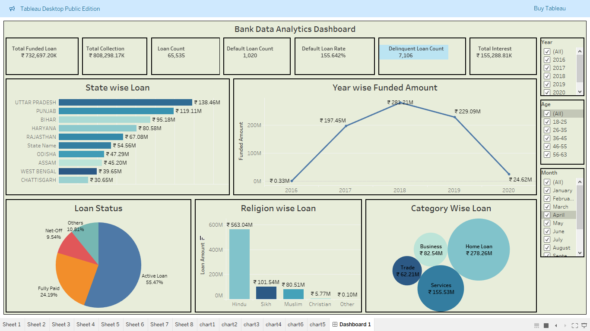
Loan Distribution Breakdown
Uttar Pradesh is the highest-funded state (₹138.46M).
Home Loans are the most common category (₹278.26M).
Active Loans form 55.47% of the total loan status.
Significant variation observed across states and loan types.

Slide 5
Trends and Demographic Insights
Peak loan funding occurred in 2018 (₹231.21M).
Sharp drop in 2020, possibly due to COVID-19 impact.
Hindu community had the highest loan uptake (₹563.04M).
Filters for Age, Year, and Month allow deeper insights.

Slide 6
Conclusion & Recommendations
Loan performance varies significantly across states and borrower types.
Monitoring delinquent and default rates can reduce risk exposure.
Diversify the loan portfolio beyond Home Loans and Services.
Deep-dive analysis by year, region, and age can improve strategy.

Slide 7
Thank you

